Slide 1

Multithreaded Programming for Mere Mortals
Emery Berger, Charlie Curtsinger, Tongping Liu University of Massachusetts, Amherst

Slide 3
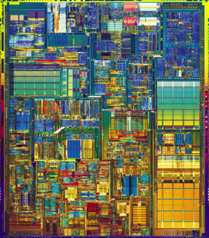
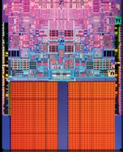

Slide 6


Slide 7
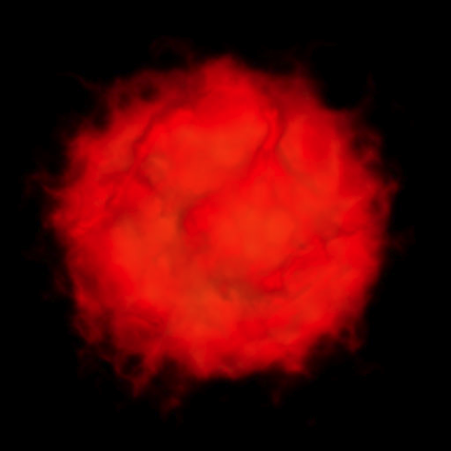

Slide 9
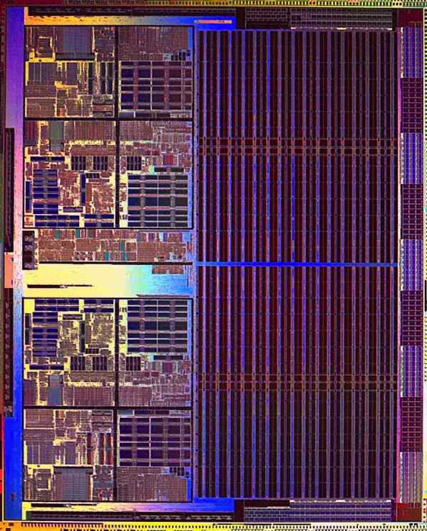

Slide 10
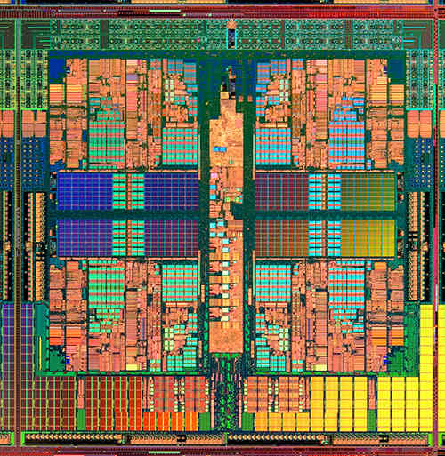

Slide 14
color = ; row = 0; // globals
void nextStripe(){
for (c = 0; c < Width; c++) {
drawBox (c,row,color);
}
color = (color == )?  : ; row++;
}
for (n = 0; n < 9; n++) {
spawn nextStripe();
}
sync;

Slide 15
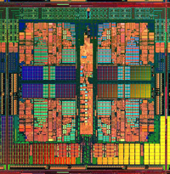
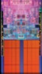
“
”

Slide 16
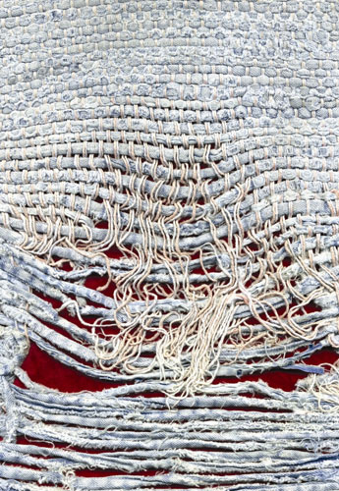
Notes:
Too few threads

Slide 17
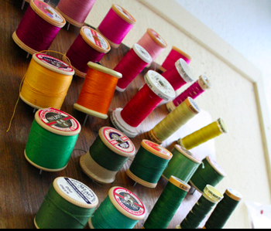
Notes:
Too many threads

Slide 18


( )
Notes:
contention

Slide 19

Notes:
One big lock

Slide 20
Notes:
Fine-grained locks (lock acquisition overhead)

Slide 21

False Sharing!
Notes:
Insidious!

Slide 22
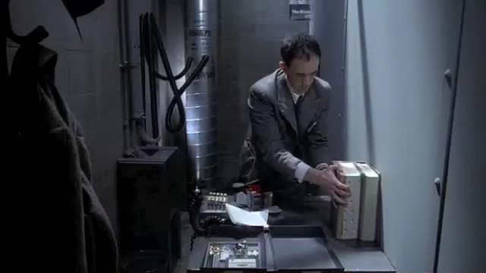
Notes:
(Brazil – didn’t know the desk was shared!)

Slide 23

mine!
yours!
cache line

Slide 24
me = 1;
you = 1; // globals
me = new Foo;
you = new Bar; // heap
class X {
int me;
int you;
}; // fields
arr[me] = 12;
arr[you] = 13; // array indices

Slide 25
Previous Tools
Instrument every access
200X slowdown, false positives
Performance counters
Fast but imprecise, false positives

Slide 26
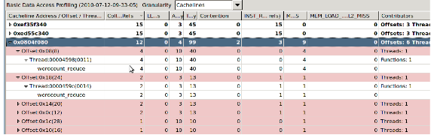

+ 850 lines…

Slide 27

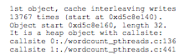
Precise
No false positives
Sheriff-Detect
Identifies heap objects by callsite, globals by name

Slide 28


Slide 29
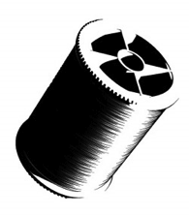
t1 = spawn f(x);
t2 = spawn g(y);
sync;

Slide 30

t1 = spawn f(x);
t2 = spawn g(y);
sync;
if (!fork())
f(x);
if (!fork())
g(y);

Slide 31

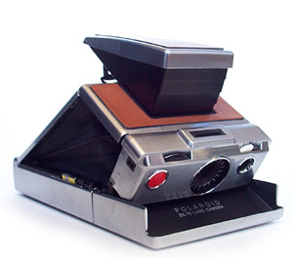

Slide 32
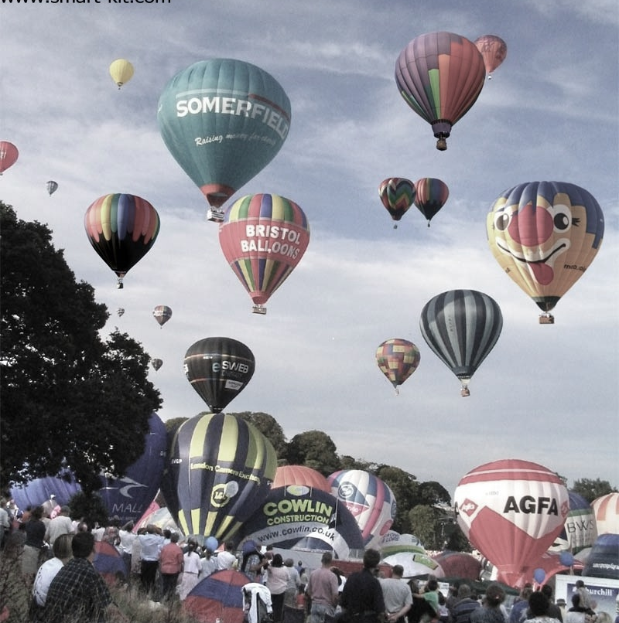
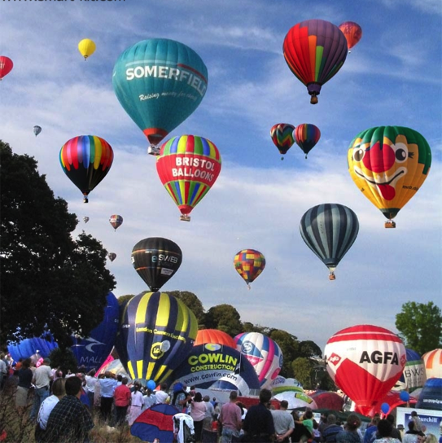

Slide 34
X
Y
for (i = 0; i < M; i++)
{
x = 1;
}
for (i = 0; i < M; i++)
{
y = 2;
}

Slide 35

X
Y
0
0
0
0
for (i = 0; i < M; i++)
{
x = 1;
}
for (i = 0; i < M; i++)
{
y = 2;
}

Slide 36
X
Y
0
0
0
0
1
0
for (i = 0; i < M; i++)
{
x = 1;
}
for (i = 0; i < M; i++)
{
y = 2;
}

Slide 37
X
Y
0
0
0
0
1
0
0
2
for (i = 0; i < M; i++)
{
x = 1;
}
for (i = 0; i < M; i++)
{
y = 2;
}

Slide 38
X
Y
0
0
0
0
1
0
0
2

Slide 39
X
Y
0
0
0
0
1
0
0
2
1
0

Slide 40
X
Y
0
0
0
0
1
0
0
2
1
0

Slide 41
X
Y
0
0
0
0
1
0
0
2
1
2

Slide 42
X
Y
0
0
0
0
1
0
0
2
1
2

Slide 47


Slide 48


Prevents all false sharing
Sheriff-Protect

Slide 49

X
Y
0
0
0
0
1
0
0
2
for (i = 0; i < M; i++)
{
x = 1;
}
for (i = 0; i < M; i++)
{
y = 2;
}

Slide 51

false sharing detection
original program
Sheriff-Detect
Sheriff-Detect

Slide 52

false sharing detection
Use Sheriff-Detect reports to guide modifications (padding, alignment)
original program
modified program
Sheriff-Detect
libpthread
False Sharing!
Sheriff-Detect

Slide 53
false sharing detection
Use Sheriff-Detect reports to guide modifications (padding, alignment)
original program
modified program
Sheriff-Detect
libpthread
False Sharing!
Sheriff-Detect
no false sharing
original program
libpthread

Slide 54

false sharing detection
Use Sheriff-Detect reports to guide modifications (padding, alignment)
original program
modified program
Sheriff-Detect
libpthread
False Sharing!
Sheriff-Detect
source code unavailable or insufficient resources to act on Sheriff-Detect reports
no false sharing
modifications degrade performance or cause excess memory consumption
original program
original program
libpthread
Sheriff-Patrol
false sharing mitigation
Sheriff-Patrol

Slide 55


Slide 56


Slide 57


Slide 58


Slide 62
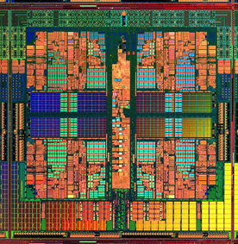
Dthreads
% g++ myprog.cpp –ldthreads –o myprog

Slide 63
race conditions
Dthreads
atomicity violations
deadlock
order violations

Slide 64

race conditions
Dthreads
atomicity violations
deadlock
order violations
deterministic

Slide 68


Slide 75
a b
a b
0 0
0 0

Slide 76
a b
a b
0 0
0 0
1 0
0 1

Slide 77
a b
a b
0 0
0 0
1 0
0 1
1 1

Slide 80
Sheriff-Detect
Sheriff-Patrol

Slide 81

Sheriff-Detect
Sheriff-Patrol

Slide 82
Sheriff-Detect
Sheriff-Patrol
Dthreads

Slide 83

Sheriff-Detect
Sheriff-Patrol
Dthreads
[OOPSLA 2011]
[SOSP 2011]

Slide 84
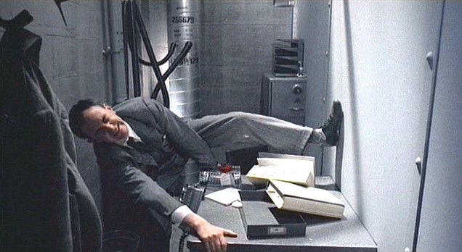
Notes:
(Brazil – didn’t know the desk was shared!)

